Slide 1

By: Pratik Panuhar

Slide 2
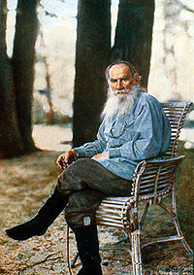
Author
Leo Tolstoy
Born in Yasnaya Polyana, Russia
on September 9th, 1828.
Died on November 20th 1910 in
Astapavo, Russia.

Slide 3
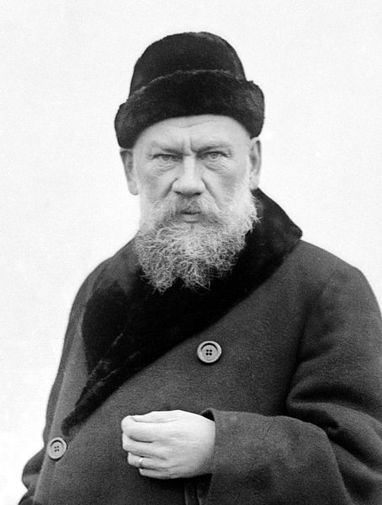
Author Background
Leo was a Russian writer who wrote several novels and short stories.
Most famous work is titled War and Peace
Married a woman 16 years
younger than him.
He had Christian beliefs

Slide 4


Slide 5
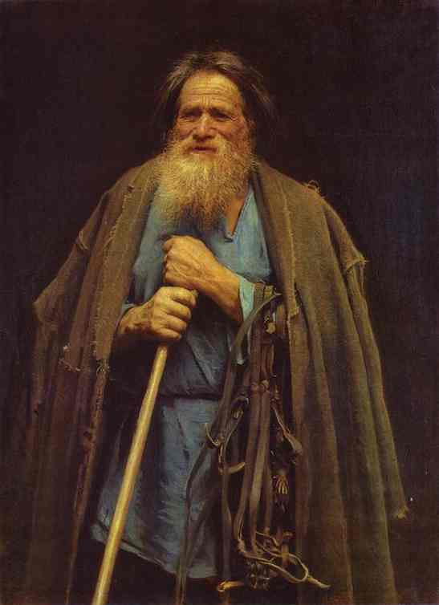
Pahom (Peasant)
Pahom the peasant is a big part of the story, and as in fact the antagonist, in the short story, “How Much Land Does a Man Need”. He is the one who receives land from the protagonist, the devil.

Slide 6

Wealthy sister
The short story includes 2 sisters. One of the two sister are very wealthy, and thinks she has it all, and loves her life.

Slide 7

Poor Sister
She is the poor sister of the two, and knows how to live with her life, and is proud of being a peasant and doesn’t like her sister bragging about being wealthy.

Slide 8
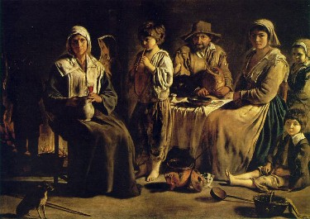
Neighbors
The Neighbors of Pahom, are angered by Pahom, since he has so much land. Pahom blames his neighbors for letting there cattle roam around his crops and land, yet it wasn’t the peasants fault. Pahom continues to anger them and soon destroy his land on purpose.

Slide 9
Scenes
Scene 1- The sister have an argument of which life is better and easier to live. Pahom is then introduced in the middle of the argument.
Scene 2- Pahom explains to other peasants that if he ever had land, he wouldn’t be afraid of anything, not even the devil himself. Little does he knows that the devil over heard his conversation.
Scene 3- The devil gives Pahom the opportunity to have lots of land, to see if what he says is true.
Scene 4- Pahom works on his land that he bought from a women named Sarah Jones. The devil gave him the opportunity and Pahom took it, and started working and growing crops.
Scene 5- Pahom’s neighbors, accidently destroy a bit of his land, by having there cattle roam, and loose fire burning his land down. In Pahom’s perspective, he thinks his neighbors are destroying his land on purpose.
Scene 6- Pahom’s neighbors are not guilty of his land being destroyed, therefore get angered by Pahom’s prosecutions, leading to his neighbors destroying his land on purpose.
Scene 7- After a hard day of repairing his land , and working hard all day he headed home with cute and bruises an his arms and legs. His land, was so big that he could not make it back home.
Scene 8- Pahom realizes that he is lost and starts to think if he will survive or not. He was bleeding injured and, doesn’t know where he is.
Scene 9- Poham eventually makes it back to his starting point, the Bashkir leader then congratulates him, but Poham then dies of exhaustion.

Slide 10


Slide 11
Literary Information
Protagonist: A peasant named pahom.
Antagonist: neighbors
Other important characters: younger sister older sister.
Setting: Russia
Conflict: Pahom wants more land.

Slide 12
Literary terms definition
Allegory- Symbolic narrative representation person or object.
Parable- what the story means
Realism- are terms that describe any manifestation
Universal theme- problem to all people

Slide 13
Literary Information
Allegory/parable- The story teaches a life lesson.
Realism- the younger sister and elder sister were talking to each other while having tea
Universal Theme- Nobody is satisfied with what they have

Slide 14
Literary Information
Themes:
Getting what you want doesn’t always mean good things will happen
A person only needs as much as they can survive on

